Slide 1
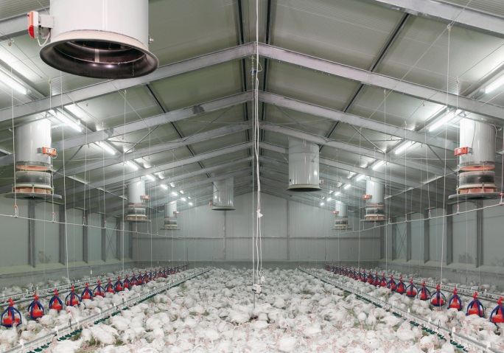
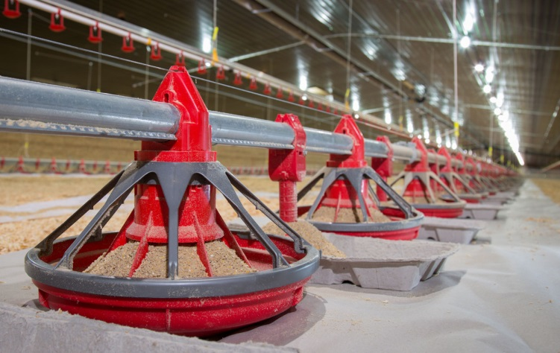
CLEANING & DISINFECTION
OF POULTRY HOUSES

Slide 2
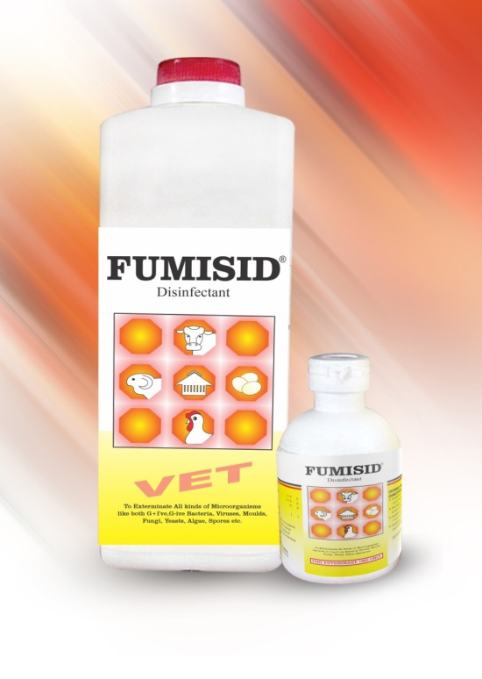
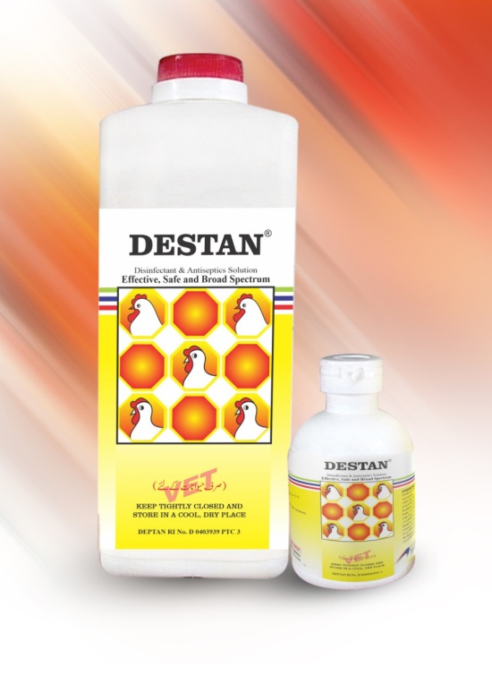
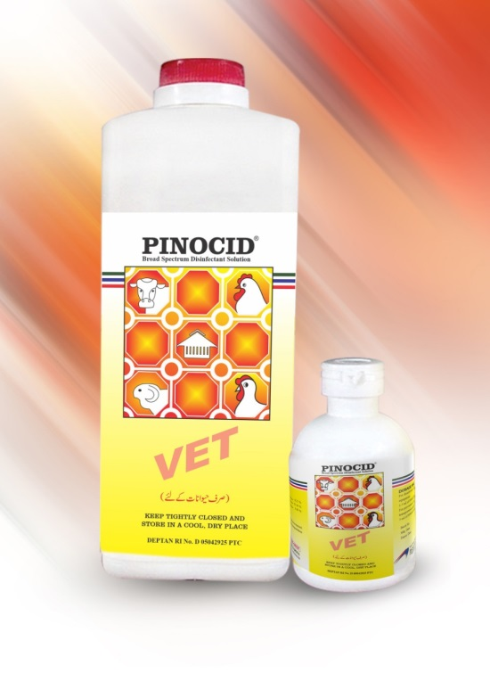



Slide 3
OBJECTIVES
By the end of this session, participants will be able to:
Define farm decontamination - cleaning and disinfection and explain what each accomplishes.
Describe different groups of disinfectants
Describe the safe use of disinfectants and explain the importance of PPE during cleaning and disinfection
Review the information on a disinfectant by reading and interpretation of a products’ label

Slide 4
CLEANING AND DISINFECTION = DECONTAMINATION
Cleaning and disinfection are key components of routine biosecurity in poultry farming
Decontamination kills any disease organisms like:
Virus
Bacteria
Parasite
Mold
that might be present on a farm at the end of a production cycle or after disease outbreak
Decontamination allows for safe re-population of a farm

Slide 5
EXERCISE
The questions!
What is a poultry farm cleaning and how its done ?
What is a poultry farm disinfection and how its done?
How do you choose a disinfectant?
What are risks involved in using disinfectants and how to avoid them?
In your group discuss what do you know about the question
Record your key points on the flipchart
Be prepared to present your answer to the group
about 10 minutes to complete this task

Slide 6
SURVIVAL OF DISEASE CAUSING AGENTS
IN THE ENVIRONMENT
DISEASE AGENT
Avian influenza
IBD (Gumboro)
Coccidiosis
Fowl Cholera
Coryza
Marek's Disease
Newcastle Disease
Mycoplasma
Salmonellosis (Pullorum)
SURVIVAL TIME
Days to months
Months
Months
Weeks
Hours to days
Months to years
Days to months
Hours to days
Weeks

Slide 7
WHAT CAN KILL DISEASE AGENTS?
Detergents / soap
Disinfectants
Sunlight
Heat (direct flame or steam)

Slide 8
CLEANING
The physical removal of foreign materials like:
Dust
Soil
Organic material such as: droppings, blood, secretions
which protect disease agents
Remember!
A good cleaning job will remove 60% of disease agents

Slide 9
CLEANING
IT IS A TWO-STEP PROCESS
Step 1. Dry cleaning
• Using a broom, brush, shovel, rag or compressed
air to remove dust, soil and dry organic material.
Remember!
Dry cleaning should not be used for cleaning poultry houses infected with air-born diseases such as: Avian Influenza or Newcastle it may cause AEROSOLIZATION of the virus and increase the risk of spreading the disease.

Slide 10
Step 2. Wet cleaning
Using detergent/soap and water.
soak the area and scrub to remove remaining
organic material as well as dirt and grease
For washing you can use common detergent powder used for cloth laundering – is cheap and effective.
Wet cleaning reduces the risk of AEROSOLIZATION of virus

Slide 11
CLEANING IS IMPROVED WITH:
Detergents / Soaps
Warm water
Scrubbing
Brushing
Power washers
Steamers

Slide 12
REMEMBER!
Disinfectants lose effectiveness during contact with disease agents.
Organic materials such as manure, blood, dust or dirt absorb disinfectants and makes them less effective.
Organic materials protect disease agents.
You must CLEAN properly before you disinfect!

Slide 13
DISINFECTION
Disinfection might kill the remaining disease agents left after cleaning.
BUT MOST IMPORTANT
Disinfection is the least reliable step of biosecurity, depends on many factors such as:
  The quality of cleaning
  The hardness of water
  Quality and suitability of disinfectant
  Correct dilution and application

Slide 14
WHAT ARE DISINFECTANTS?
Disinfectants are chemicals that
Slow down disease agents activity, multiplication and their growth
or
Kill disease agents

Slide 15
COMMON TYPES OF DISINFECTANTS
• Disinfectants are divided into several groups based on their chemical structure
Like:
Halogens (Iodophors and Chlorines, Halamid®, Dettol®)
Alcohols
Oxidizing Agents (Hydrogen-Peroxide, Hyperox®, Virkon®)
Phenols (Fenix®, Prophyl 75®)
Aldehydes (Glutheraldhyde – TH4®, Formalin)
Quaternary ammonium compound (Timsen® Beloran ®, Bromosept®)

Slide 16
CHOOSING THE RIGHT DISINFECTANT
The choice of disinfectant will depend on the following:
Cost
Type of disease agent/s to be destroyed
Amount of contamination by organic matters such as:
Droppings, blood and manure left in the poultry house
Active ingredient
The chemical compound and concentration that its contained

Slide 18
READING THE LABEL OF DISINFECTANTS
Before using any disinfectant the label MUST be read and
understood.
The label gives you valuable information.
Caution or warning
Dangerous Poison
Slightly Toxic
Highly Toxic
Extremely Toxic

Slide 19
DISINFECTANTS ARE DANGEROUS !
Disinfectants are dangerous chemicals = poisons
We have to be careful when we use disinfectants
Disinfectants might cause poisoning:
  Acute (fast) toxicity with certain disinfectants may
  Cause: dizziness, nausea and itchy eyes or skin
  Chronic (slow) toxicity may occur gradually over many years may cause: permanent disability because the body has become very sensitive

Slide 20
How dangerous a disinfectant is?
Depends on:
The type of substance and what it is made of
The speed and the way it enters the body
The amount of substance that enters the body

Slide 21

ABSORPTION RATE
Scalp = 3.7
Ear= 5.4
Forehead = 4.2
Eyes = 12
Palm = 1.3
Nose = 6
Abdomen = 2 Arm = 1
Groin = 11
Feet = 2
A splash in the eyes is absorbed 12 TIMES faster than a splash on the arm.

Slide 22
POISONING
Chemicals can enter your body through 3 ways:
  1. through the lungs when breathing or smoking
  2. through the mouth when eating and drinking
  3. through the skin and eyes
Remember!
  When handling chemicals you need to make sure you
  wear the right clothes and equipment for your protection

Slide 23
PROTECT YOUR
MOUTH AND LUNGS
Breathing in disinfectant vapors or spray particles
The main danger exist when:
  Mixing chemicals
  Spraying in confined spaces
  Using fumigants such as formaldehyde or chlorine
Accidental drinking of chemical by drinking (by children)

Slide 24
WEAR RESPIRATORS
If the label states a respirator to be worn then TOXIC vapors will be released.
You must use a full face or half face respirator fitted with appropriate filters
Remember!
Dust or biological masks are not designed to filter chemical’s spray droplets and vapors

Slide 25
EYE PROTECTION
Contamination of the eyes can result from:
  Drift, splash or spill of chemicals
  Rubbing eyes with contaminated hands or clothing
Chemical absorbed through the eye very rapidly
Always wear eye protection when handling or spraying chemicals
Use: goggles or face shield

Slide 26
SKIN ABSORPTION
Absorption is highest when temperature is hot and skin is perspiring (hot season)
Longer chemicals are in contact with skin, the more chemical is absorbed.
Don’t wait! wash your skin with soap and plenty of water
immediately
Clothing which has been sprayed must be removed as soon as possible and washed with soap and water

Slide 27
PROTECT HANDS AND ARMS
• Gloves that cover the forearms are the best.
• Make sure they are resistant to chemicals -PVC).
• Turn base of glove over when spraying overhead

Slide 28
BODY PROTECTION
• Overalls and gloves
• Wide brim hat
• Rubber boots
NO

Slide 29
APRONS FOR EXTRA PROTECTION
PVC or neoprene aprons extending from neck to
ground give excellent front protection from spills
and Splashes
Easy to put on and wash
Use when mixing chemicals

Slide 30
REMEMBER!
Always wash your hands and face with soap after spraying disinfectant
Never eat or smoke when spraying disinfectant

Slide 31
Quiz
1. Organic matter increases the effect of disinfectants
true or false
2. How would you define Decontamination?
3. Name 3 essential pieces of protective clothing to be used when spraying disinfectant.
4. Under what (3) conditions can chemical vapors, dusts or spray particles be inhaled to cause poisoning?

Slide 32
What do you think ?
1. What are the 3 key points you want to remember from this module?
2. What additional information do you need on this module?

Slide 33


THANK YOU.

